Slide 1
Scalable Nearest Neighbor Based Hierarchical Change Detection Framework for Crop Monitoring
Presenter: Zexi Chen
Date: 2/16/16
Computer Science Department
North Carolina State University

Slide 2
Introduction
Vegetation covers 70% of our earth land surface, and helps maintain ecological balance and provide food, but it is easy affected by climate, environment and humans’ activities
Monitoring inter-annual changes in vegetation and cropping patterns over large geographic regions is important for many applications, like biofuel development, climate change detection
Remote sensing imagery data provide an effective way of monitoring and management of vegetation. The MODIS instrument in the satellite provides daily coverage, moderate spatial resolution satellite images of most areas of the earth.

Slide 3
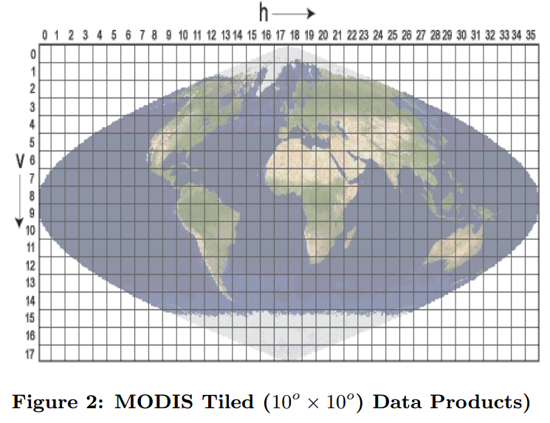
Big Data Challenge
The monitoring requires processing more than 300 tiles, each tile consists of 4800*4800 pixels. And the data is available for last 10 years on daily basis.=> 7 billion time series.

Slide 4
Problem Statement
Problem Definition:
Developing a scalable algorithm to detect inter-annual changes in croplands using MODIS imagery at 250-meter spatial resolution.
The Data description
The imagery data consists of 4800*9600 pixels at each timestamp. And the images are available on a bi-week basis spanning from 2001 to 2011

Slide 5
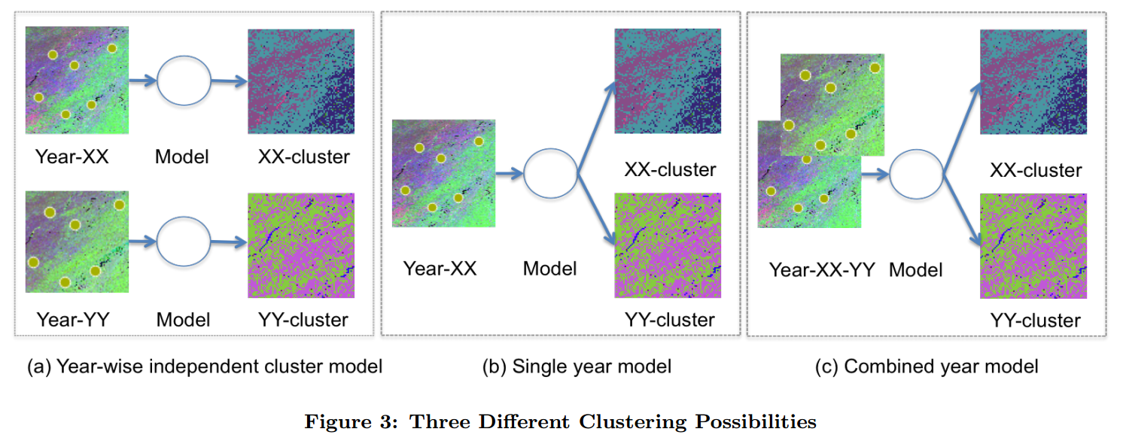
State of Art
Three possible approaches when designing a clustering based change detection

Slide 6
State of Art
In previous study, Gaussian Mixture Model is used to detect changes, which ignore the temporal properties, and the EM algorithm in the model is prone to local optima and takes large amount of time to converge.
K-mean clustering is not suitable for modeling temporal correlations, which will over predict the changes

Slide 7
The workflow of the Algorithm
Perform random sampling from the two relevant years of original dataset
Build a cluster hierarchy model
Pick different number of clusters at multiple levels from the dendrogram
Perform k-Nearest Neighbor classification based label assignment to the whole time series imagery data,
Generate change map based on inter-annual cluster memberships using hierarchical relationships between the cluster labels

Slide 8
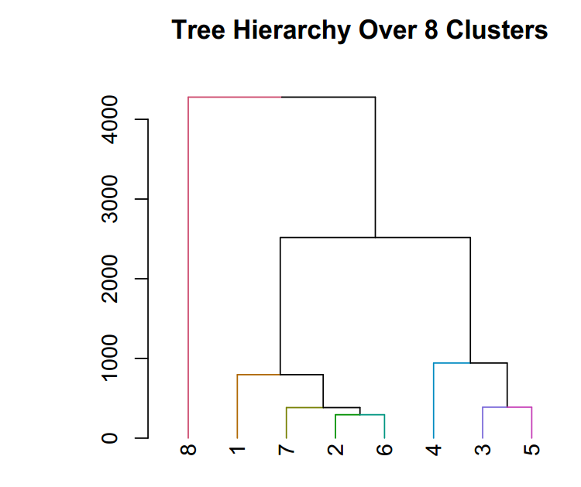
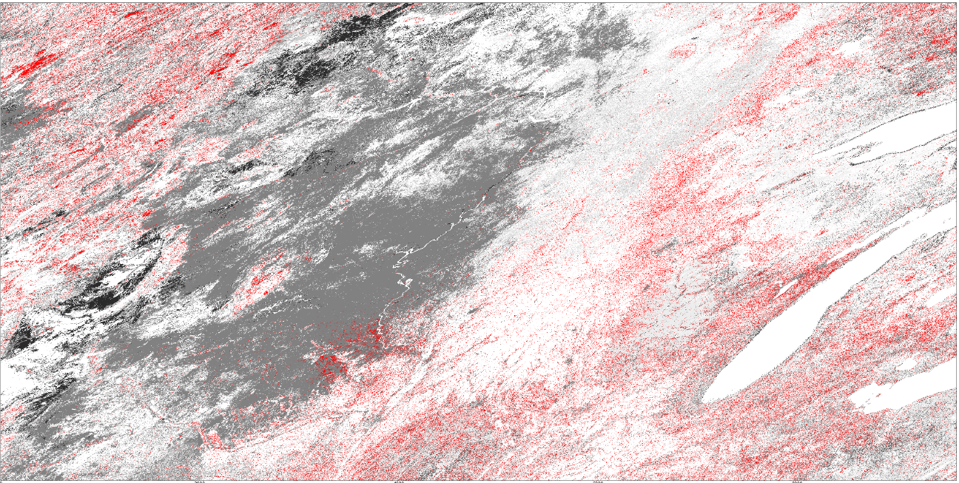
Change Detection

Slide 9
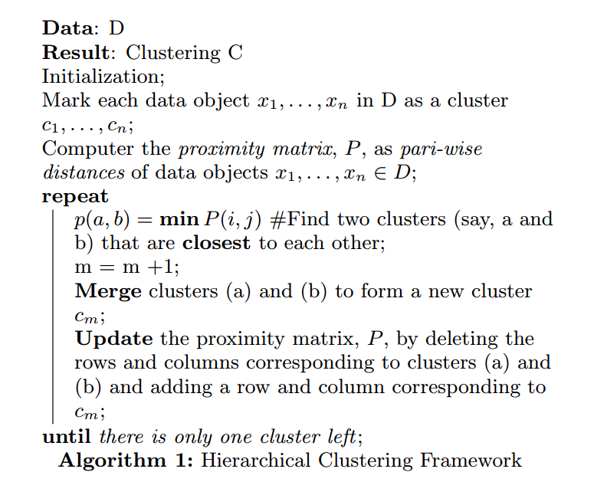
Hierarchical Clustering
Hierarchical clustering is a popular clustering techniques which works by grouping objects into an hierarchy.

Slide 10
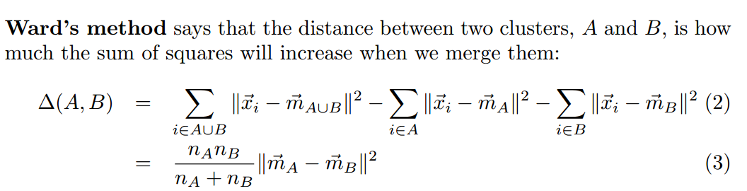
Hierarchical Clustering
Different methods for the computation of the proximity between clusters:
Single Link
Complete Link
Group Average
Centroid-based
Ward’s method(I choose, because the similarity between the time series within each cluster are respectively higher)

Slide 11
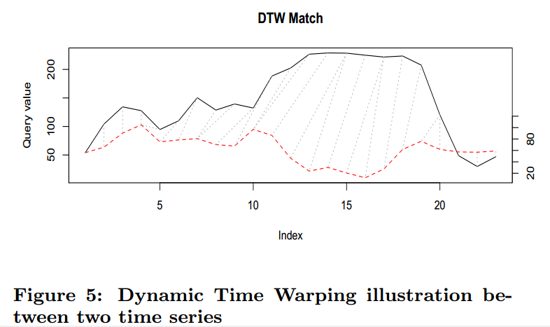
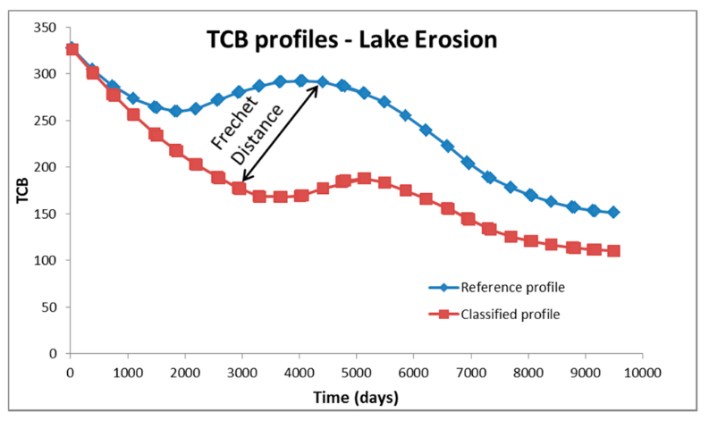
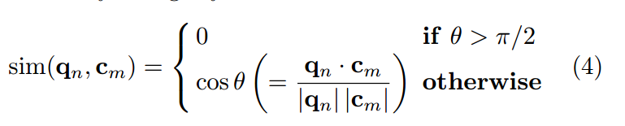
Time Series Distance Measures
Different Distance Measures:
Euclidean distance
DTW(Dynamic Time warping)
Frechet Distance
Cosine Distance(shape based measurement, not based on individual points)
Frechet distance

Slide 12
K-Nearest Neighbors Classifier
As the computational complexity of hierarchical clustering is too high(O(n^3)), which is not applicable for our large data set. We sample hundreds of time series from the original time series imagery data to build the hierarchical clustering.
Use the built hierarchical clustering model to assign label to each time series imagery data
However, if we use the centroid of each cluster to find the similarity, we lose the information of the subtle differences within the members in the cluster.
Instead, we preserve all the time series curves and use k-nearest neighbor to predict labels

Slide 13
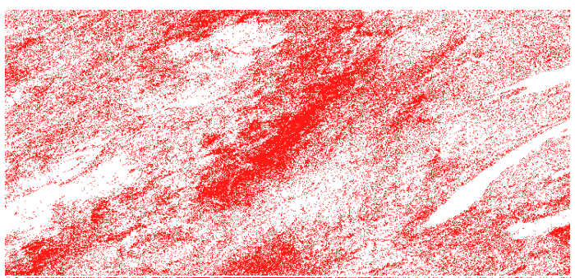
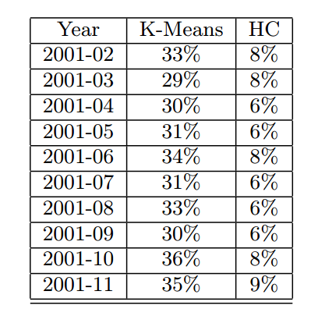
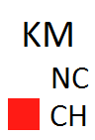
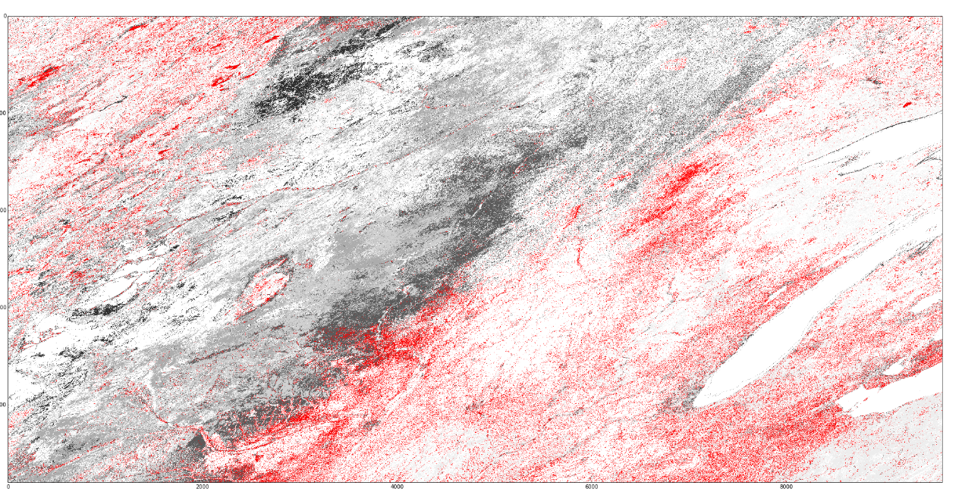
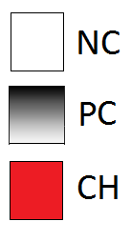
Experiments
K-mean based change results(2006) with 2001 as reference year
Hierarchical k-NN change results(2006)
with 2001 as reference year using DTW
as the distance measurement and sample
size 1000.

Slide 14
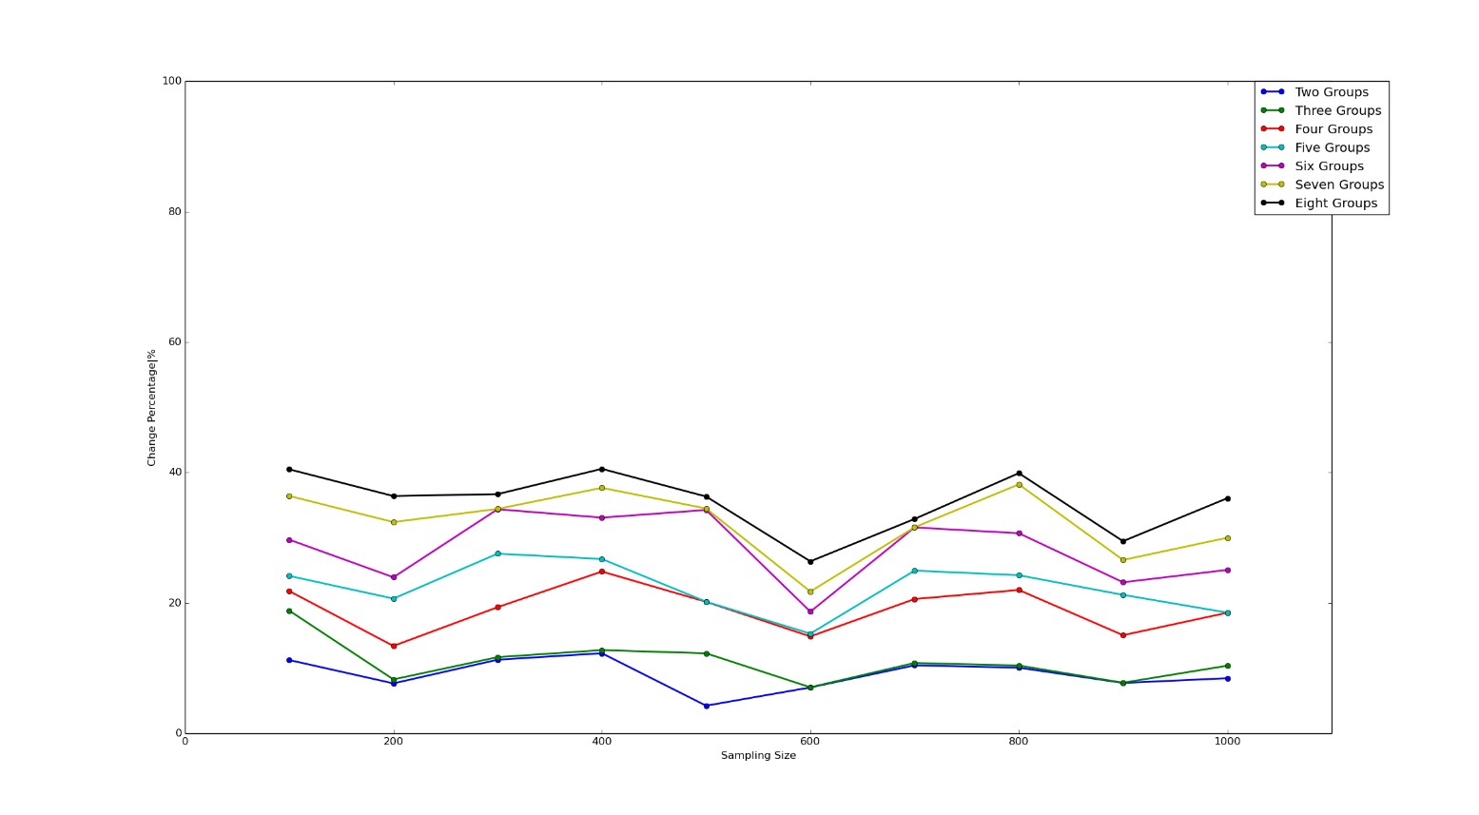
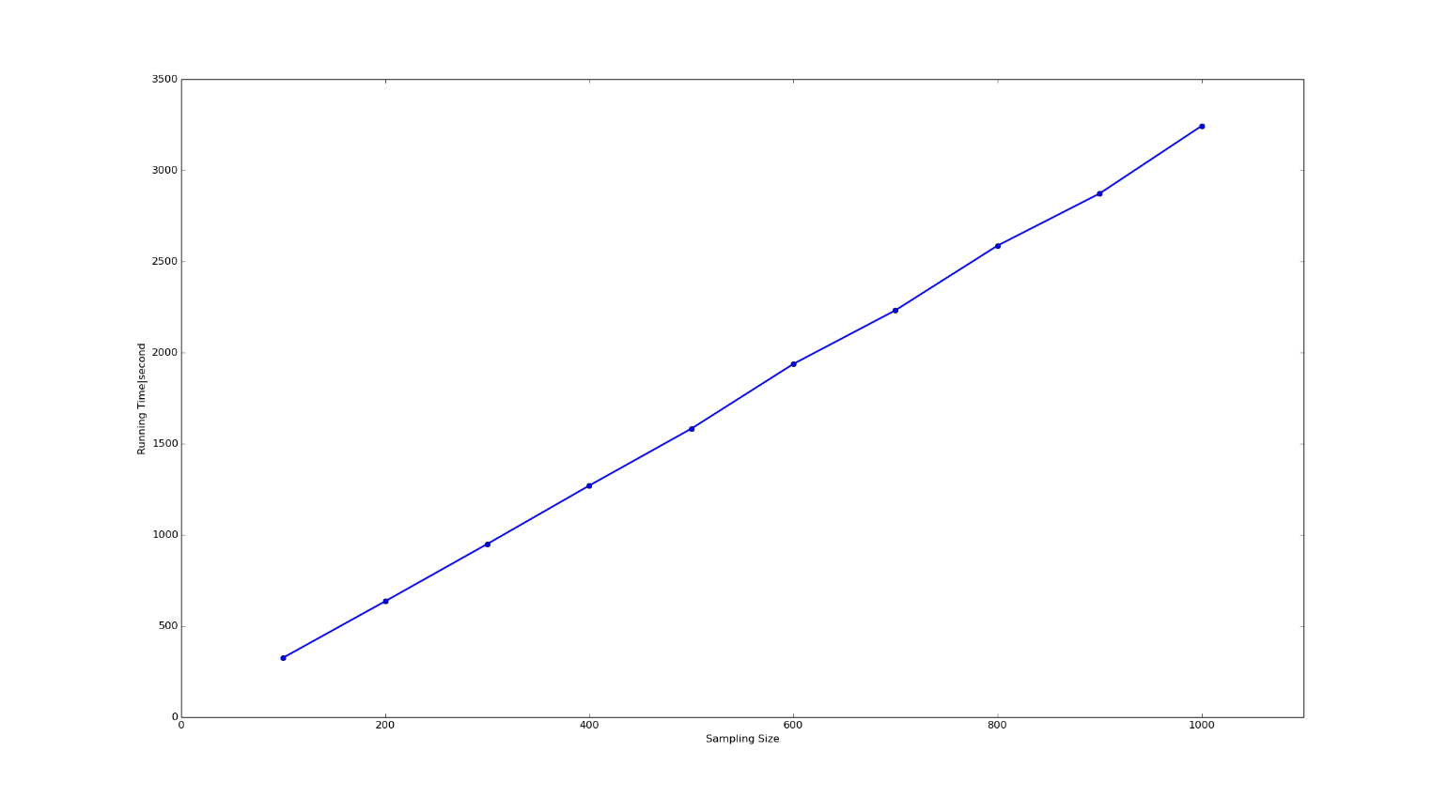
Experiments
Change percentage with different sample size
Running time with different sample size
DTW measure based change results 2006 for different sample sizes with 2001 as reference year using hierarchical k-Nearest Neighbors Framework

Slide 15
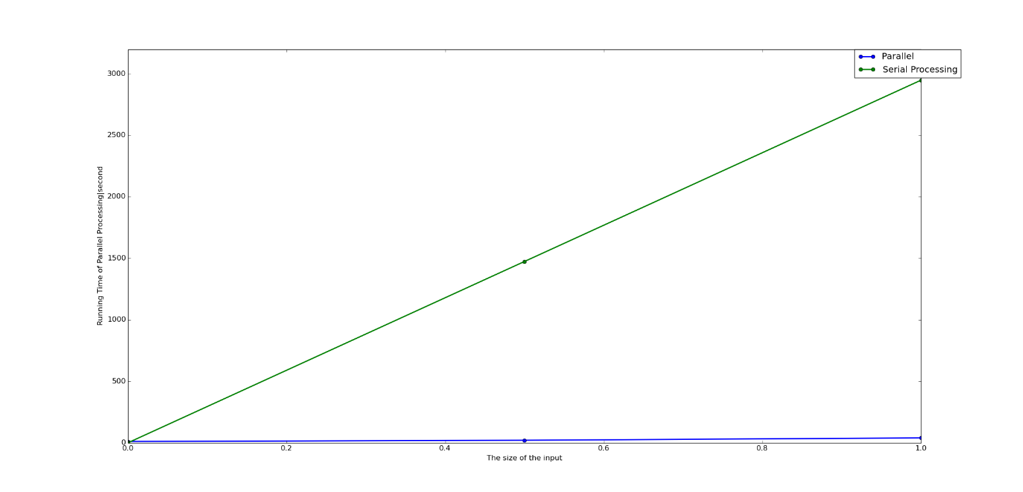
Experiments
GPU based implementation of similarity matrix computation to show the scalability of our algorithm
The fraction of the data size transfer from CPU to GPU at each time | Running time of Parallel process(second)
1/2 | 39.9
1/4 | 39.71
1/20 | 39.84
1/100 | 40.66
1/500 | 41.4
1/1000 | 43.06
1/2000 | 46.71
1/4000 | 53.03
1/8000 | 55.49
1/10000 | 68.4
1/15000 | 98.74
1/20000 | 125.76
1/40000 | 247.14
The parallel processing is almost 74x times faster than serial processing, which shows the scalability of the algorithm.
The comparison of the parallel processing
running time for different chunk size
transferring from CPU to GPU with Euclidean
distance as measurement and sample size 200

Slide 16
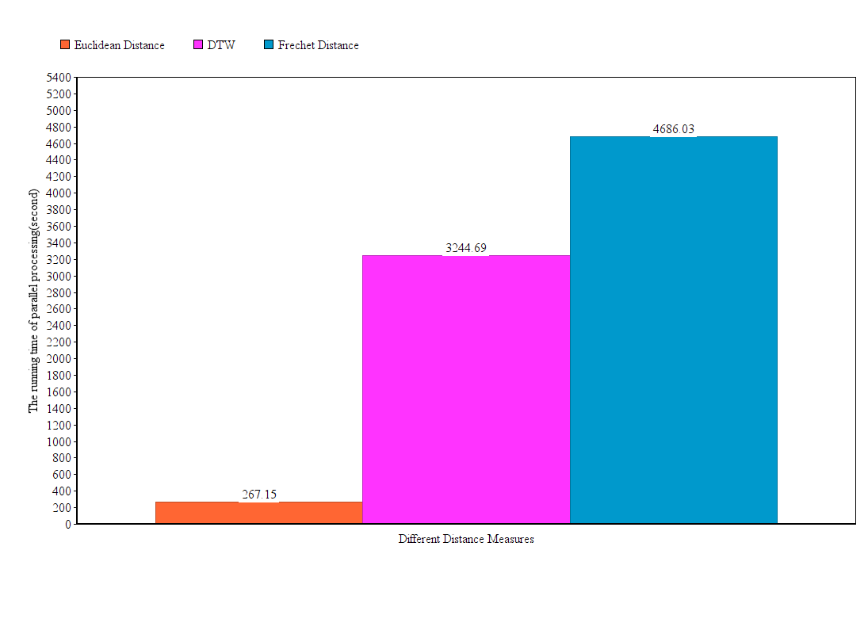
Experiments
The running time comparison with three different distance measures with fixed sample size 1000

Slide 17
Future Work
Use ground truth data to validate our model
Take into account the autocorrelation of the spatial data

